Slide 1
JSON
Course: Web Frontend Development I
Name: Dereck Romero Moscoso
Instructor: Brother Mike Odom

Slide 2
What is JSON
JSON stands for JavaScript Object Notation
JSON is a lightweight data interchange format
JSON is a plain text written in JavaScript object notation
JSON is used to send data between computers
JSON is language independent
Source W3schools

Slide 3
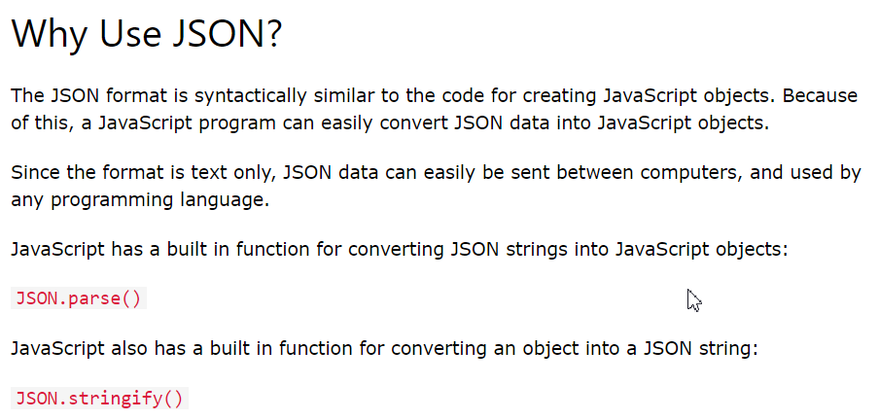
Why to use JSON
W3schools

Slide 4
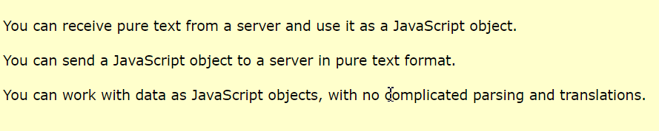
Why to use JSON
W3schools

Slide 5
JSON Types
Strings “aName” “animal” “sign”
Numbers 3 -54 0.54
Null null
Arrays [“Dad”, “Mom”, “Son”] [0,1,2,3,4]
Objects {“key”: “value”} {“dog”: “poodle”} {“parrots”: 3 }

Slide 6
JSON File
filename.json
{
“name”: “Francisco”,
“Age”:70,
“favoriteFood”: [“lobster”, “lasagna”, “pizza”, “chesse burger”],
“lovedOnes”: [{
“name”: “Mom”,
“favoriteFood”: [“pizza”, “hamburger”]}
{“name”: “Dad”,
}
}

